Slide 1
Neural Nets with Pytorch
Session 2: Multilayer Perceptrons

Slide 2
Handling Data
Pytorch convenience classes:
data.Dataset: Handle reading, transforming, and returning data.
data.Dataloader: Handle batches of data
Can build your own dataset classes - for now we’ll use built-ins

Slide 3

Handling Data
Fashion-MNIST
One of many datasets which comes with torch

Slide 4
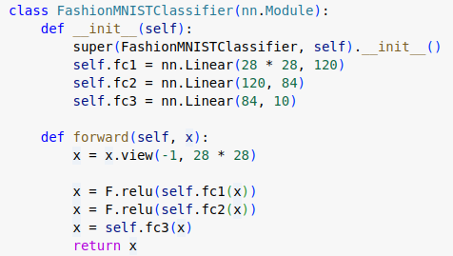
Building an MLP
Define a class inheriting from nn.Module
Define the layers: nn.Linear for an MLP
Describe how data will flow forward through the network.
Done!

Slide 5
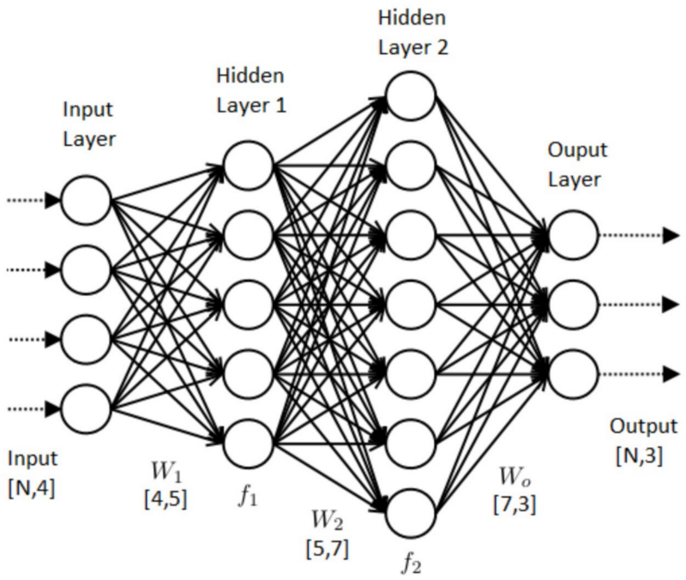
Training an MLP
outputs = model(inputs)
loss.backward()

Slide 6
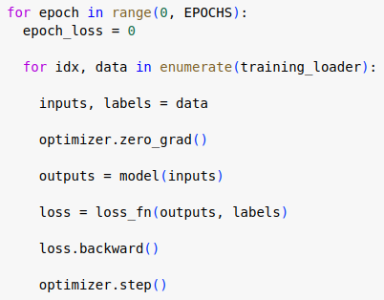
Training Loops
Get a batch of data
Zero out accumulated gradients
Forward pass
Compute loss
Compute gradients
Backward pass
Update model weights

Slide 7
Practical Worksheet

